Slide 1
Edge Advanced Bootcamp
Fault Rules and Error Response

Slide 2
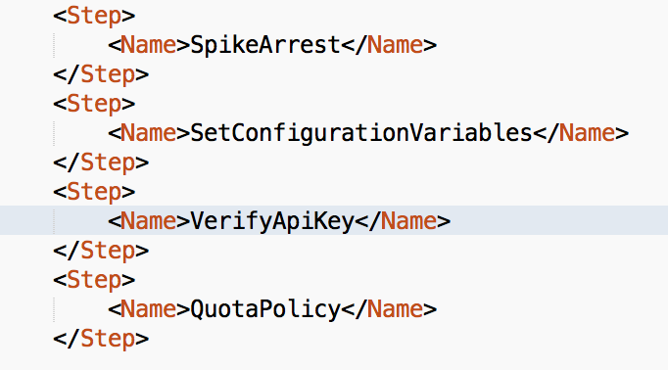
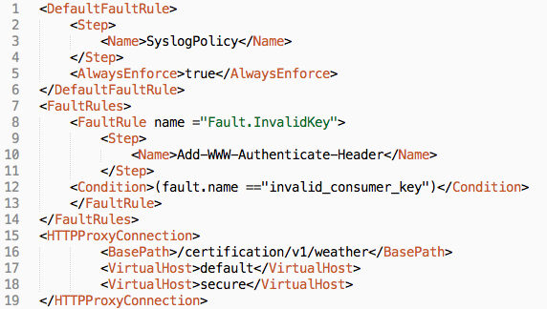
Fault Handling
Faults in Edge are similar to exceptions in programming languages.
When a fault is raised, current policy processing is aborted and switches to error processing called <FaultRules>. This is supported in Proxy Endpoint and Target Endpoint configurations only.
Notes:
http://apigee.com/docs/api-services/content/fault-handling

Slide 3
Fault Handling (cont’d)
<FaultRule>
Support for multiple fault rules, executed conditionally
Raised manually or automatically upon policy failure
If multiple conditional FaultRules defined, their conditions are evaluated in reverse order (bottom up).
<DefaultFaultRule>
A catch-all / post processing fault rule is available using the flow
If no FaultRule is matched, this flow will execute.
Use <AlwaysEnforce>true</AlwaysEnforce> to use this flow for post processing in error flows. This will ensure the flow executes after a matched fault rule has completed its processing.
3 scenarios where processing will switch to fault processing:
Using RaiseFault policy
Any policy failure when contineOnError=false (default setting)
Non-success response received from service callout or backend request (4XX, 5XX status codes).
Notes:
http://apigee.com/docs/api-services/content/fault-handling

Slide 4
Rewriting Backend Error Responses
Edge has a pre-defined fault response format:
You can either:
Rewrite backend error responses to match Edge’s format
Rewrite Edge fault responses to match the backend error response format
{
"fault":{
"faultstring":"%errorMessage#",
"detail":{
"errorcode":"%errocode#"
}
}
}
Notes:
http://apigee.com/docs/api-services/content/fault-handling

Slide 5
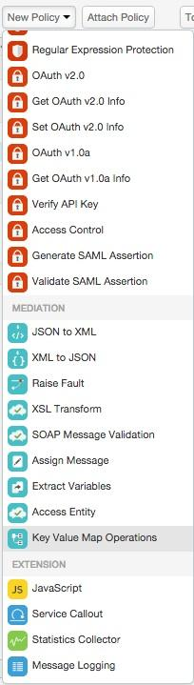
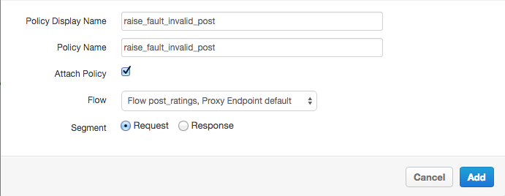
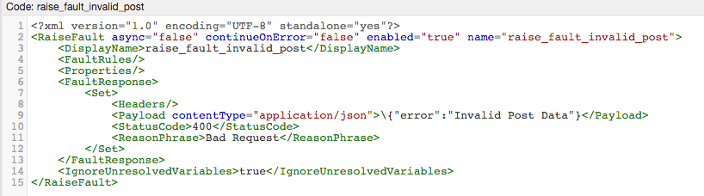
Raising a Fault (error)
Add a Raise Fault Policy
Name and Select the Proxy Endpoint (Ratings (Post)) from the flows, then press Add
Modify the content to return an appropriate fault message

Slide 6
Raise Fault Policy Details
Fault Response Tag Format
If empty it will redirect request / response flow to the fault rules for handling
Set – Allows you to build an inline response to fault
StatusCode – HTTP Status Code
ReasonPhrase – HTTP Reason Phrase
Payload – Message Contents for your fault (follows same spec as assign message)
Copy – Allows you to copy the request or the response into the fault response
Attr:source – request or response object
Note : Raise Fault can also be used as a mechanism to stop the request flow before getting to the target in a success scenario.

Slide 7
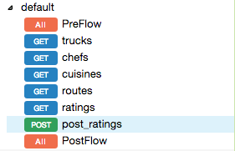
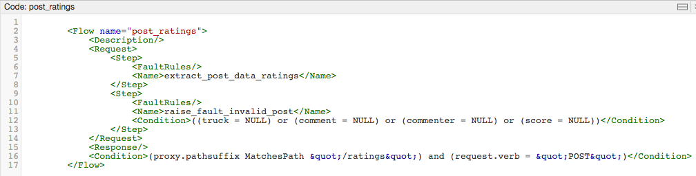
Raise Faults work with conditions
Select Post Ratings Resource from navigation pane
Add a condition to the Step (policy)

Slide 8
THANK YOU

